Slide 1
FMI BLOCKCHAIN
ФМИ, СУ
Александър Панайотов

Slide 2

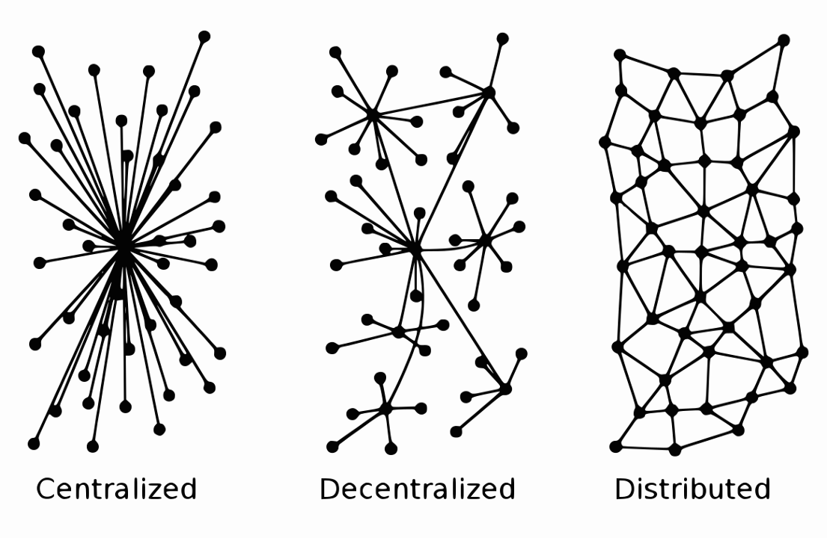
Types of networks

Slide 3
Blockchain
Taxonomy

Slide 4

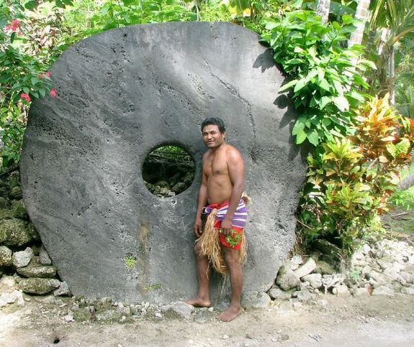
Decentralised Ledger
Technology (DLT)
The purpose of a ledger
Yapese island
DLT vs Centralized
Possession vs ownership

Slide 5
A blockchain
Blockchain vs DLT
  Append only ; entire history
3 components:
  Blockchain, consensus, network
3 transactions types
Architectural overview + terms
  Merkle tree, blocks, hashing, transacting etc…

Slide 6
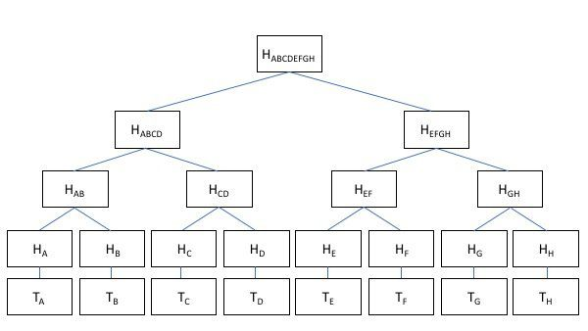
Merkle tree

Slide 7
Assignment
1 example of blockchain app (dApp)
  Biz case (problem, how it works)
  Biz model (monetization)
  Architecture (technology, platform, etc.)

Slide 8
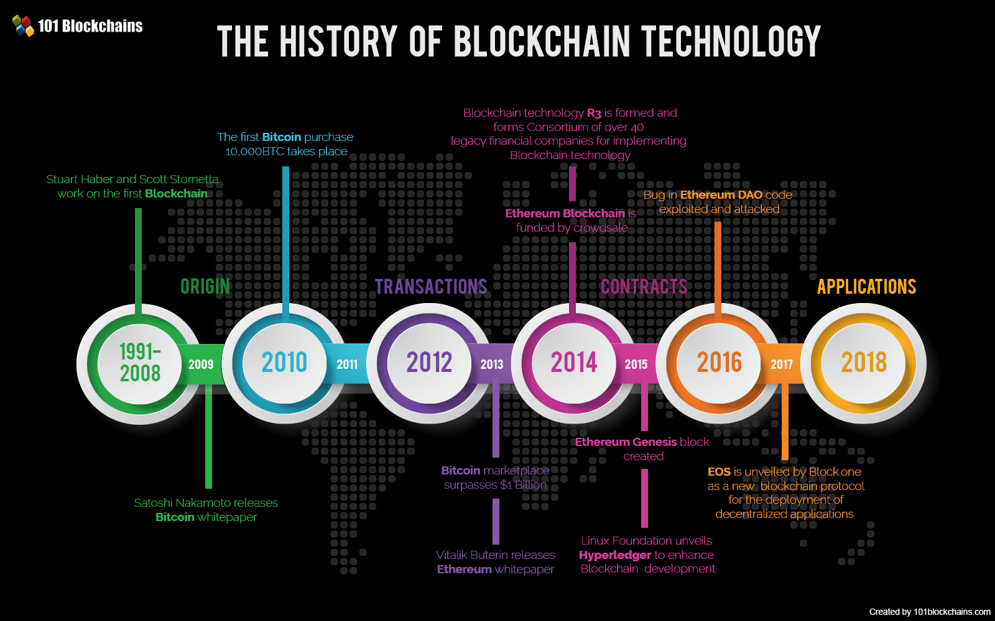

Slide 9

Public Blockchain
Bitcoin, 2009
Characteristics

Slide 10
Blockchain
Benefits
Drawbacks
Trustless environment
Immutability
Provenance
Finality
Disintermediation
Infinitely scalable (horizontal)
Not understood
Used for unethical purposes
Mistaken with cryptocurrency
Throughput Scalability

Slide 11
Private blockchain
Performance > security & transparency
No anonymity
Smaller
Different roles and levels of access
Different consensus (BFT)

Slide 12
Comparison
Public
Private
Anonymous
Secure
Total transparency
PoW
More efficient in cost
Scalable
High transaction throughput
PBFT

Slide 13
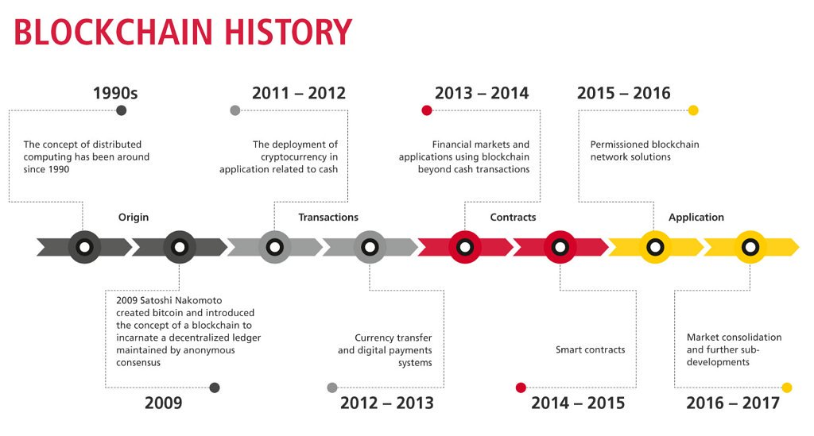
Timeline

Slide 14
Public key cryptography
Cryptographic function
  Secret, key, function, cipher
Public/Private key
Cryptographic hashing

Slide 15
Public and Private Keys
Public = H(Private) == Wallet address
Public key encrypts or confirms
Private key signs or decrypts

Slide 16
DEMO

Slide 17
Where Can Blockchain
Be Used
Banking
Business
Healthcare
Retail
Public sector
Cyber security
Games
IoT
Big data

Slide 18
Thank you!

